Slide 1
V- CARE WELFARE ASSOCIATION (N.G.O)
REGISTERED AT THANE REG. NO F/ 19997/THA
U/S 12A OF THE I.T. ACT 1961:THN/CIT-11/12A(a)295/2012-13
U/S80G OF THEI.T ACT,1961 THN/CIT-11/TEC/ATG/295/2012-13
NITI AAYOG UNIQUE ID MH/2017/0175219
REGISTER WITH UNITED NATIONS DEPARTMENT OF ECONOMIIC AND SOCIAL AFFAIRS

Slide 2
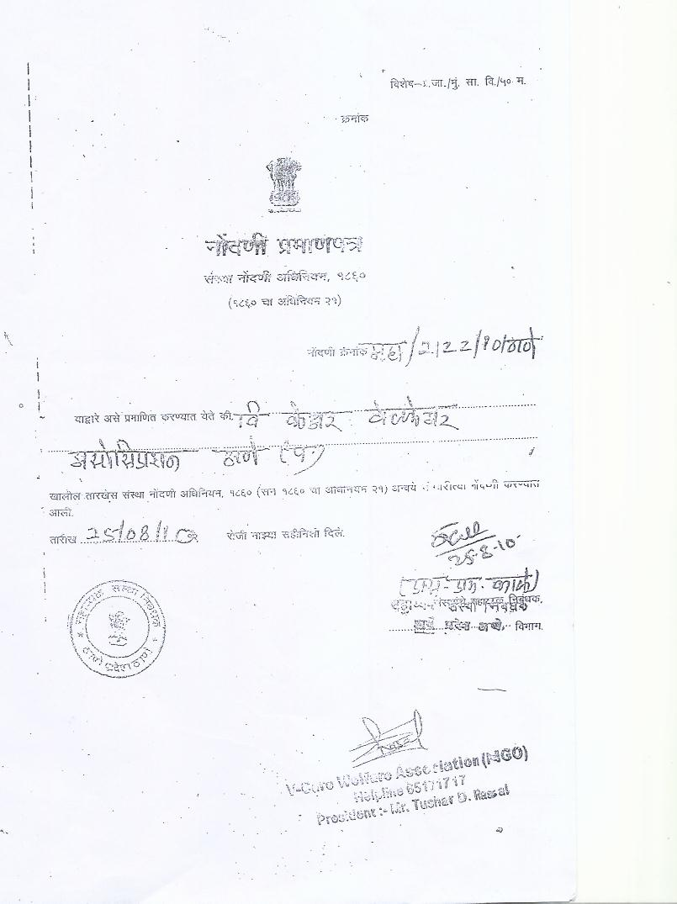
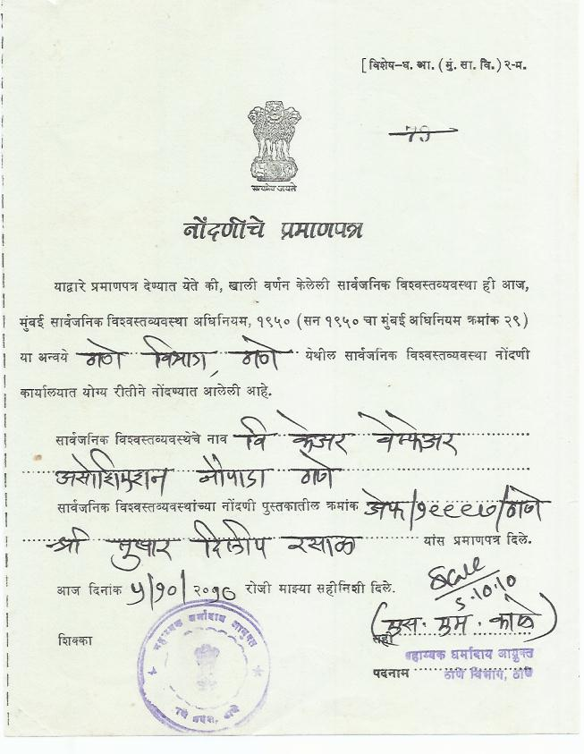
REGISTRATION CERTIFICATE

Slide 3
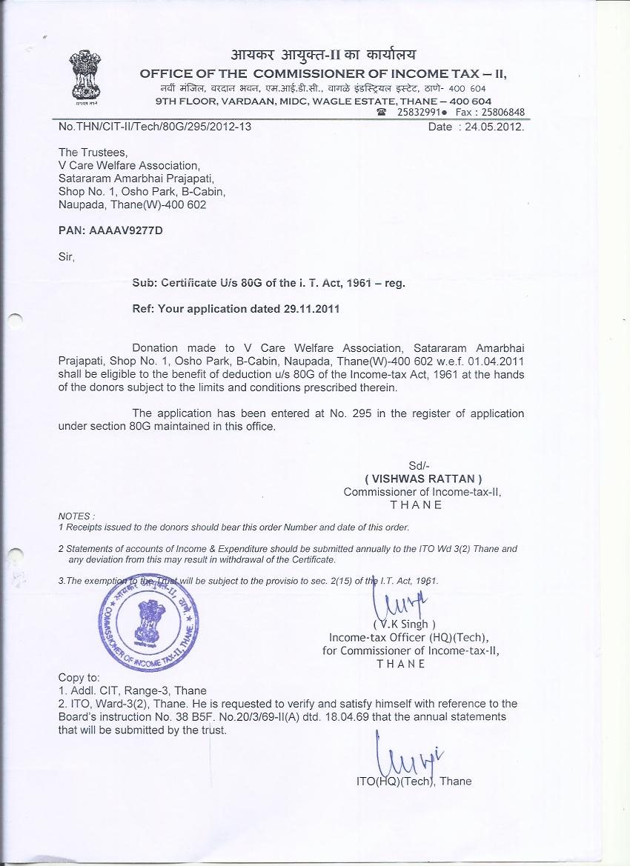
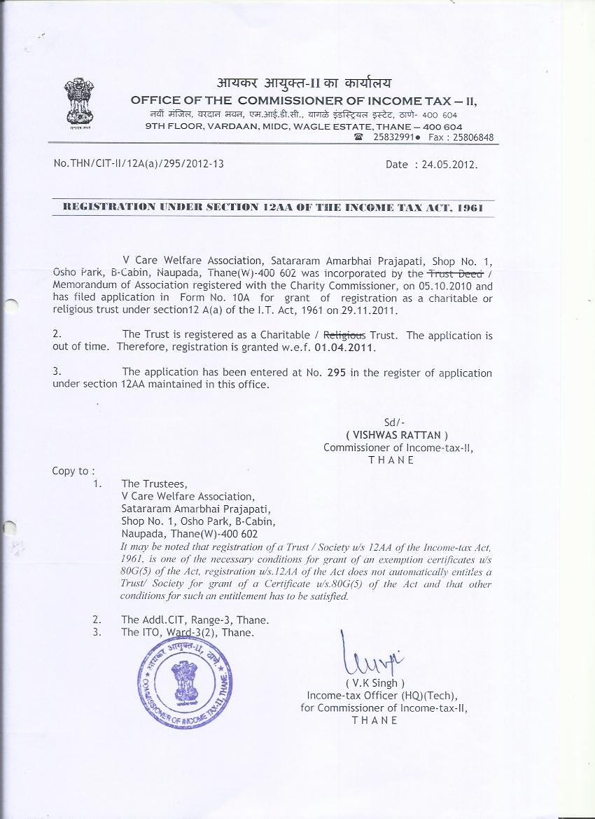
V CARE 80G CERTIFICATE &
12 A CERTIFICATE

Slide 4
V-CARE WELFARE ASSOCATION (N.G.O.) TRUSTEES
Mr. Tushar Dilip Rasal- President
Mr. Nitin Bhoi- Vice President
Mr. Pankaj Tawade- Secretary
Mr. Sudarshan Bhoir- Treasurer
Mr. Hemal Boricha
Mr. Jay Dhuri
Mrs. Aarti Rasal
Mr. Mangala karandikar- Chief advisor
Dr. Jayprakash Ghumatkar- Chief Advisor

Slide 5
V-CARE WELFARE ASSOCATION (N.G.O)
EDUCATION
SPORTS
MEDICAL
DISABLES
POVERTY
ENVIRONMENT

Slide 6
VISION
A strong “giving” culture where Indians donate 2% of their income every year to give the poor a chance. A happy, health and creative child whose rights are protected and honoured in a society that is built on respect for dignity, justice and equity for all. A vibrant “philanthropy market place” to ensure that the most efficient and effective nonprofits get access to the most resources.

Slide 7
MISSION
To enable people to take responsibility for the situation of the
deprived human being and so motivate them to seek resolution Through individual and collective action thereby enabling children to realise their full potential for action and change. To enable people’s Collectives and movements encompassing diverse segment, to pledge their particular strengths, working in partnership to secure, protect and honour the rights of India’s children.

Slide 8
OUE BELIFES AND APPROACHES
SACRIFICE :- we believe that every individual must ‘give till it hurts’, demonstrating
the willingness to share one’s fortunes with those less privileged.
DESERVE OUR NEEDS :- we believe that we need to earn our keep, rather than
assume it is as a right. We need to give first and then ask in return.
ADDING VALUE :- we believe that we add value only when we do something that
no one else is currently doing, or when we do it in a better way.
PASSION :- v-care believes that working with a ‘burning desire’ to make a
difference, is the greatest motivator to do something meaningful.
FIRST PRINCIPLES APPROACH :-v-care believes that we must do things
because they make sense to do, and not simply because that is how everyone else does
it. Blind faith is the enemy of all innovation.
FOCUS ON THE POOREST :- all that v-care does is directed towards improving the
lives of our ‘real customer’ – the poorest of the poor.
TRANSPARENCY AND ACCOUNTABILITY :- as ‘trustees’ of tax payer
resources, we believe in being proactively accountable and transparent in that we do
and to all our stakeholders.

Slide 9
PURPOSE
EDUCATION :- we are providing free seminars on sex education, basic computer and
IT education, free beautician courses for women and tutions for those who cant afford
heavy tution fees during academic education process.
POVERTY :- we are trying to change to view of poor people to look after their life and
help them to develop their personal skills in various commercial sector and to get
good approurtinity in job or to run their own small scale business.
ENVIRONMENT :- we are into plantation of various types of trees and preventing
them from being cutting to maintain ecological balance and increasing global
warming.
MEDICAL SECTOR :- we are helping mankind with support if local government authority
to run camps on polio, all kind of vaccionation, total health checkup and blood
donation camps. Beside this we had started charitable hospital at naupada thane,
maharashtra to help needy people.
SPORT :- we want to provide good platform for sports and sport person support sportsmen to
achieve his/her goal in their sport carrier promoting sport is also our mission.
DISABILITY :- providing help to disables and make them self esteem providing new platform for
disables for their up liftment.

Slide 10
BICYCLE DONATION

Slide 11
Many children in rural Maharastra go to school walking 5 kms to 6 kms daily. Most of their energy and time is consumed in travlling to school.
There is no means of transport due to bad condition of roads and where roads are good transportation is not affordable.
To over come this situation we had planed solutoin to distribute bicycal to such students.

Slide 12
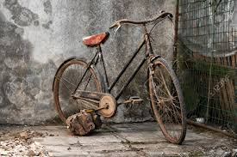
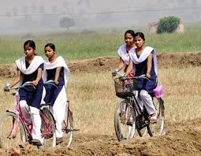
*Near our residence we always come across bicycle
a at corridor of our society or near our residency
Which is not in used by children long back.
*This bicycles are just like extra dump material
to us after some day we will give this to scrab
dealer at cheap price.
*We V-Care Welfare Association (N.G.O)
Appeals you to donated such bicycles to
us so we can give it to right person.

Slide 13
V-CARE WELFARE ASSOCATION (N.G.O.)
OFFICE NO :- 02265171717
TUSHAR RASAL:- 9833690011
SUDARSHAN BHOIR:- 9022976999
FOR DONATION JUST CALL US ON BELOW NUMBER
OUR VOLUNTEER WILL COLLECT BICYCLES FROM YOUR ADDRESS

Slide 14
V-CARE WELFARE ASSOCATION
(N.G.O.)
REG. OFFICE :- OFFICE NO.1, OSHO PARK, SHIVAJI NAGAR, NAUPADA,
THANE (W), 400 602.
OFFICE ADDRESS :- OFFICE NO. 4,SHREE KRUSHNA APPT, OPP T.B.Z. JWELLERS,
NAUPADA , SHIVAJI NAGAR, THANE, (W) 400602.
HELP LINE NO :- 022-65171717
WEBSITE :- www.vcarengo.org
Email :- info@vcarengo.org

Slide 15
V-CARE WELFARE ASSOCATION
(N.G.O.)
THANK YOU
V-CARE
FAMILY

