Slide 1
CENSUS OF INDIA 2011 DATA ON DISABILITY
REGISTERED AT THANE REG. NO F/19997/THA
U/S 12A OF THE I.T. ACT 1961:THN/CIT-11/12 A(a)295/2012-13
U/S 80G OF THE I.T ACT,1961 THN/CIT-11/TEC/ATG/295/2012-13
NITI AAYOG UNIQUE ID MH/2017/0175219
REGISTER WITH UNITED NATIONS DEPARTMENT OF ECONOMIC AND SOCIAL AFFAIRS

Slide 2
BACKGROUND
So far the data released from census 2011 pertained to :
House listing and housing census
Primary census abstract (PCA) covering final results on:
Total population, SC, ST populations, literates, workers, non-workers and categories of economic activity by sex and residence
PCA on slums and houseless population
PCA for scheduled castes and scheduled tribes
Age data in five-years age groups and single-year age returns

Slide 3
Present Dataset
The present set of results pertains to data collected in the census 2011 on disability
Information on disability of individuals was collected during the population enumeration phase of census 2011 through ‘household schedule’. Similar information was collected during 2001 census also. Information for individuals residing in ‘Normal’, ’institutional’ and ‘Houseless’ household was collected.
The table C-20- ‘disabled by age-group and type of disability’ has been generated on the basis of processing 100% census schedules.
Note : the fingers exclude the population of Mao Maram, Paomata and Purul sub-
divisions of Senapati district of Manipur.

Slide 4
Historical Perspective
The question on disability was canvassed in all the Censuses since 1872 to 1931
The question on disability was not canvassed in the Censuses from 1941 to 1971
In Census 1981, information on three types of disability was collected
The question was dropped in Census 1991
In Census 2001, the question was again included and information on five types of disability was collected
In Census 2011 information on eight types of disability has been collected

Slide 5
Question Canvassed in Census 2011
Q. 9
Disability
9(a) is this person mentally/ physically disabled?
Yes-1/no-2
9(b) if ‘yes’ in 9(a), give code in the box against
9(b) from the list below
9(c) if ‘multiple disability’ (code “8”) in 9(b), give
maximum three codes in boxes against
9( c) from the list below
9(a)
9(b)
9(c)
Q.9 Disability
In seeing……..1 In hearing…....2 In speech…….3 In movement...4 | Mental retardation..5 Mental illness….6 Any other…7 Multiple disability..8

Slide 6
Features of Disability Question, 2011
Has a filter question to ascertain disability status
Attempts to collect information on eight types of disabilities as against five in census 2001.
Designed to cover most of the disability list in the “persons with disability act, 1995” and “the national trust act, 1999”.
The placement of the question on disability in the census schedule was changed. The question was brought forward at Q-9 at census 2011. this was the question no.15 at the census 2001.

Slide 7
Special Efforts made to Improve Coverage
TRAINING
•Intensive training at various levels including National Trainers, Master Trainers Facilitators
•Training imparted by experts from disability sector using specially developed training modules
•Role models from disability groups were invited in training classes to motivate and sensitize Census functionaries
•National Centre for Promotion of Employment for Disabled People (NCPEDP) and its alliance partners were associated in developing training modules, imparting training and sensitizing census functionaries.

Slide 8
Special Efforts made to Improve Coverage (Contd.)
PUBLICITY
•Wide publicity through electronic and print media undertaken.
•Special audio/ video spots prepared in 12 languages for awareness and were telecast on all popular TV and Radio channels across the country
•Every video clip had disability component,
•Special E-learning module prepared to show as to how to approach and extract information on disability from respondents
•Leaflet on disability was prepared and distributed among media persons
•Seminars and workshops were held at State level to create awareness
•Banners and Posters on disability displayed
•Events like Auto Rickshaw rally, car rally, Cycle rally etc. were organized
•At Census Directorate level many innovative modes of publicity were used
•Enumerators’ kit included a special flier on disability

Slide 9
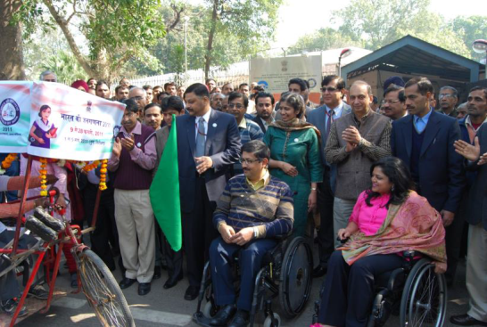
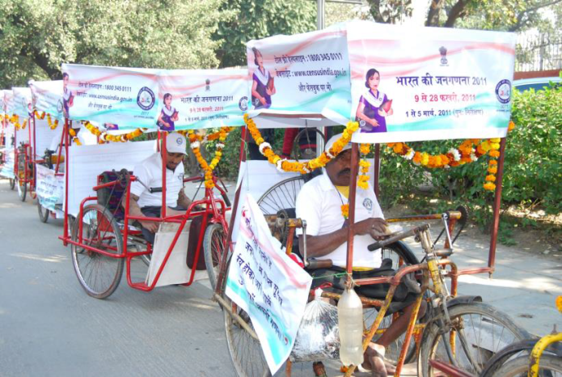
Special Efforts made to Improve Coverage
(Contd.)
Cycle rickshaw rally at new Delhi by the disabled

Slide 10
Special Efforts made to Improve Coverage (Contd.)
Posters and banners
Leaflet on disability for media kit

Slide 11
Definition Changes 2001-11
Types of disability | Change in definition
In seeing | One eyed persons were treated as disabled at census 2001. at the census 2011 such persons have not been treated as disabled in seeing. At the census 2011 enumerators were asked to apply a simple test to ascertain blurred vision. At census 2001 no such instructions were given.
In hearing | person using hearing aid have been treated as disabled at census 2011. they were not treated as disabled at the census 2001. persons having problem in hearing through one ear although the other ear is functioning normally was considered having hearing disability in census 2001. but in census 2011, such persons were not considered as disabled.
In speech | Definition was made clearer in census 2011 to record persons with speech disability. For instance, “ persons who speak in single words and are not able to speak in sentences” was specifically mentioned to be treated as disabled.

Slide 12
Definition Changes (Contd.)
Types of disability | Change to Defination
In movement | Specific mention of the following was made in the definition for census 2011. Paralytic persons those who crawl those who are able to walk with the help of aid have acute and permanent problems of joints/muscles have stiffness or tightness in movement or have loose, involuntary movements or tremours of the body or have fragile bones have difficulty balancing and coordinating body movement have loss of sensation in body due to paralysis, leprosy etc. have deformity of body like hunch back or are dwarf.

Slide 13
Definition Changes (Contd.)
Types of disability | Change of definition
Mental retardation | New category introduced at census 2011. mental retardation was covered under the category of mental disability at census 2001.
Mental illness | New category introduced at census 2011. mental illness was covered under the category of mental disability at census 2001.
Any other | New category introduced at census 2011 to ensure complete coverage. This option enabled respondents to report those disabilities which are not listed in the question. In such cases, where informant was not sure about the type of disability this option of reporting disability as ‘any other’ was available to her/him.
Multiple disability | New category introduced at census 2011. the question has been designed to record as many as three types of disability from which the individual was reported to be

Slide 14
Data Highlights

Slide 15
Disable Population by sex and Residence India: 2001-11
Disabled population by sex and residence India, 2011
Residence | person | males | females
Total | 26,810,557 | 14,986,202 | 11,824,355
Rural | 18,631,921 | 10,408,168 | 8,223,753
urban | 8,178,636 | 4,578,034 | 3,600,602
Decadal change in disables population by sex and residence, India 2001-11
 | Absolute increase | Percentage decadal growth
residence | person | males | females | persons | males | females
Total | 4,903,788 | 2,380,567 | 2,523,221 | 22.4 | 18.9 | 27.1
Rural | 2,243,539 | 997,983 | 1,245,556 | 13.7 | 10.6 | 17.8
urban | 2,660,249 | 1,382,584 | 1,277,665 | 48.2 | 43.3 | 55.0

Slide 16
Disable Population by Sex and Residence India: 2011
Percentage of disabled to total population india,2011
residence | persons | males | Females
Total | 2.21 | 2.41 | 2.01
Rural | 2.24 | 2.43 | 2.03
urban | 2.17 | 2.34 | 1.98
Percentage of disabled to total population india,2001
residence | persons | males | Females
Total | 2.13 | 2.37 | 1.87
Rural | 2.21 | 2.47 | 1.93
urban | 1.93 | 2.12 | 1.71

Slide 17
Disable Population by Residence India: 2001-2011
Proportion of disabled population by residence India : 2001-2011
Percentage of disabled persons in India has increased both in rural and
urban areas during the last decade.
proportion of disabled population is higher in rural areas
decadal increase in proportion is significant in urban areas

Slide 18
Disabled Population by Sex India: 2001-2011
slight increase in disability among both the sexes
over the decade
proportion of disabled population is higher among
males
Decadal increase in proportion is higher among
females

Slide 19
Proportion of Disabled Population India and States/ UTs: 2011

Slide 20
Disability by Social Groups India: 2011
Proportion of disabled population by social group India, 2011
Social group | person | males | females
Total | 2.21 | 2.41 | 2.01
Scheduled castes | 2.45 | 2.68 | 2.20
Scheduled tribes | 2.50 | 2.18 | 1.92
Other than SC/ST | 2.18 | 2.37 | 1.98

Slide 21
Disability by Social Groups India: 2011
Proportion of disabled population
by social groups:
India, 2011 (%)

Slide 22
Disable Population by Type of Disability India : 2011
Disable Population by Type of Disability India : 2011
TYPES OF DISABILITY | Person | males | females
Total | 26,810,557 | 14,986,202 | 11,824,355
In seeing | 5,032,463 | 2,638,516 | 2,393,947
In hearing | 5,071,007 | 2,677,544 | 2,393,463
In speech | 1,998,535 | 1,122,896 | 875,639
In movement | 5,436,604 | 3,370,374 | 2,066,230
Mental retardation | 1,505,624 | 870,708 | 634,916
Any other | 722,826 | 415,732 | 307,094
Multiple disability | 2,116,487 | 1,162,604 | 953,883

Slide 23
Proportion of disabled population by Type of Disability India : 2011
Proportion of disabled population by type of disability India : 2011
disabled population by type of disability (%) India : 2011 (Persons)
Types of disability | persons | males | Females
Total | 100.0 | 100.0 | 100.0
In seeing | 18.8 | 17.6 | 20.2
In hearing | 18.9 | 17.9 | 20.2
In speech | 7.5 | 7.5 | 7.4
In movement | 20.3 | 22.5 | 17.5
Mental retardation | 5.6 | 5.8 | 5.4
Mental illness | 2.7 | 2.8 | 2.6
Any other | 18.4 | 18.2 | 18.6
Multiple disability | 7.9 | 7.8 | 8.1

Slide 24
Disable by Type and Sex India : 2011
Disable by Type and Sex India : 2011
disability in seeing and hearing is more
among females
Disability in movement is more among males

Slide 25
Disable Population by Type and Residence (%) India : 2011
Disability by type and residence,
India, 2011
disability in hearing and speech is more in urban areas
disability in movement and multiple disability is more in rural areas.

Slide 26
Disable Population by Type and Social Group (%) India : 2011
Percentage share of disabled population by type of disability among social groups India : 2011
Disability in seeing, hearing and movement and multiple disability is more among STs than of SCs and other
Disability in speech and mental retardation is more among others than that of SCs and STs
Type of disability | total | SCs | STs | OTH
TOTAL | 100.0 | 100.0 | 100.0 | 100.0
IN SEEING | 18.8 | 19.1 | 20.0 | 18.6
IN HEARING | 18.9 | 17.4 | 19.3 | 19.2
IN SPEECH | 7.5 | 5.2 | 5.3 | 8.3
IN MOVEMENT | 20.3 | 20.5 | 22.5 | 20.0
MENTALRETARDATION | 5.6 | 5.1 | 4.9 | 5.8
MENATL ILLNESS | 2.7 | 2.4 | 2.6 | 2.8
ANY OTHER | 18.4 | 22.9 | 16.5 | 17.4
MULTIPLE DISABILITY | 7.9 | 7.3 | 8.9 | 7.9

Slide 27
Percentage Share of Disables Population by Type and Social Group India : 2011
disability in seeing, movement and multiple disability is more among STs than that of SCs and other
disability in speech and mental retardation is more among others than that of SCs and STs

Slide 28
Disabled Population by age and Sex India : 2011
Proportion of disabled population in the respective age groups India: 2011
Age group | Persons | Males | Females
All ages | 2.21 | 2.41 | 2.01
0-4 | 1.14 | 1.18 | 1.11
5-9 | 1.54 | 1.63 | 1.44
10-19 | 1.82 | 1.96 | 1.67
20-29 | 1.97 | 2.22 | 1.70
30-39 | 2.09 | 2.41 | 1.77
40-49 | 2.31 | 2.66 | 1.94
50-59 | 2.83 | 3.16 | 2.47
60-69 | 4.15 | 4.41 | 3.89
70-79 | 6.22 | 6.26 | 6.19
80-89 | 8.41 | 8.33 | 8.48
90+ | 8.40 | 7.88 | 8.85
Age not stated | 3.07 | 3.21 | 2.91

Slide 29
PROPORTION OF DISABLED POPULATION IN THE RESPECTIVE AGE GROUPS India : 2001-11

Slide 30
Proportion of Disabled Population in the Respective Age Groups age groups by sex India : 2011

Slide 31
Percentage of Disables Population to total Population of the Age Group

Slide 32
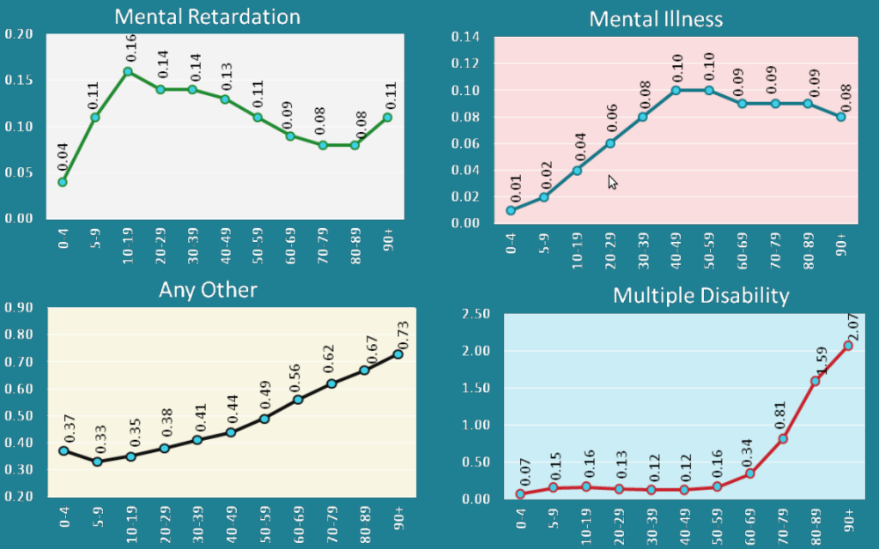
Percentage of Disables Population to total Population of the Age Group (Contd.)

Slide 33
Disable Population by age and Social Group India : 2011
Proportion of disabled population in the respective age groups – (SCs, STs and Others) India:2011
disability among STs in lower age-groups upto 40-49 is significantly lower than the other social groups
in the higher age group i.e.60 onwards, it is high among STs
disability among SCs is invariably higher than others in all age-groups
Age group | total | SCs | STs | OTH
ALL AGES | 2.21 | 2.45 | 2.05 | 2.18
0-4 | 1.14 | 1.25 | 0.95 | 1.15
5-9 | 1.54 | 1.67 | 1.37 | 1.53
10-19 | 1.82 | 1.98 | 1.64 | 1.81
20-29 | 1.97 | 2.21 | 1.73 | 1.94
30-39 | 2.09 | 2.38 | 1.83 | 2.06
40-49 | 2.31 | 2.64 | 2.14 | 2.26
50-59 | 2.83 | 3.30 | 2.95 | 2.72
60-69 | 4.15 | 4.89 | 5.13 | 3.90
70-79 | 6.22 | 7.45 | 8.45 | 5.81
80-89 | 8.41 | 9.79 | 11.55 | 7.97
90+ | 8.40 | 9.06 | 10.30 | 8.14
AGE NOT STATED | 3.07 | 3.25 | 2.78 | 3.06

Slide 34
Disable Population by age and Social Group ( Contd.) India : 2011
Proportion of disabled population
by age SCs, STs and others
India,2011
disability among STs in lower age-groups up to 40-49 is significantly lower than the other social groups
in the higher age group i.e. 60 onwards, it is high among STs
disability among SCs is invariably higher than others in all age-groups

Slide 35
HELP LINE NO :- 022-65171717
WEBSIT :- www.vcarengo.org
Email :- info@vcarengo.org
THANK YOU

