Slide 1
V- CARE WELFARE ASSOCIATION (N.G.O.)
REGISTERED AT THANE REG. NO F/19997/THA
U/S 12A OF THE I.T. ACT 1961:THN/CIT-11/12 A(a)295/2012-13
U/S 80G OF THE I.T ACT,1961 THN/CIT-11/TEC/ATG/295/2012-13
NITI AAYOG UNIQUE ID MH/2017/0175219
REGISTER WITH UNITED NATIONS DEPARTMENT OF ECONOMIC AND SOCIAL AFFAIRS

Slide 2
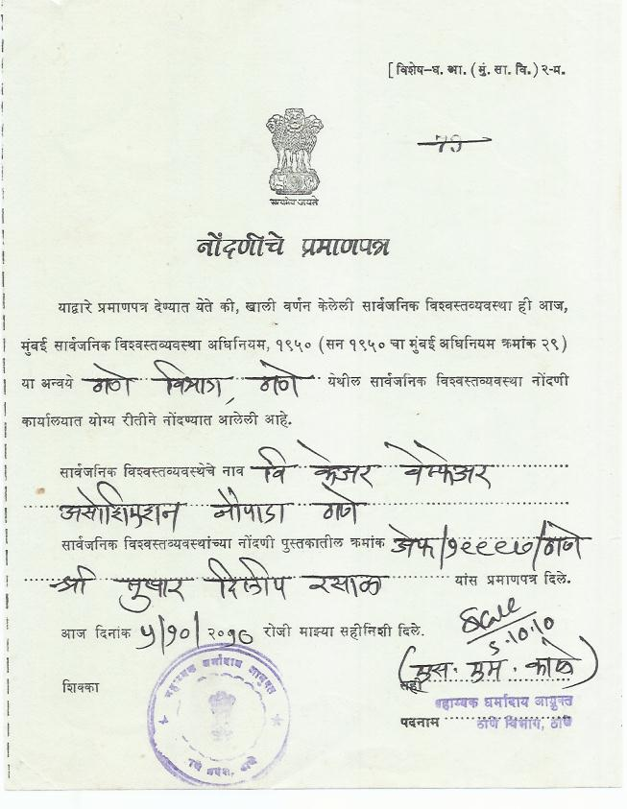
REGISTRATION CERTIFICATE

Slide 3
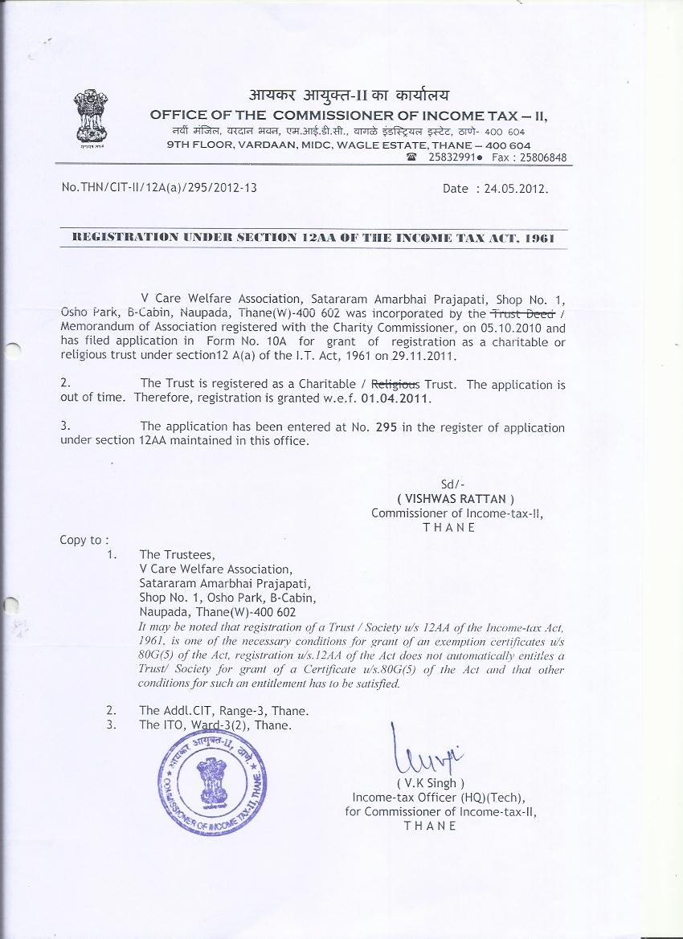
V CARE 80G CERTIFICATE & 12 A CERTIFICATE

Slide 4
V-CARE WELFARE ASSOCATION (N.G.O.) TRUSTEES
Mr. Tushar Dilip Rasal- President
Mr. Nitin Bhoi- Vice President
MR. Pankaj Tawade- Secretary
Mr. Sudarshan Bhoir- Treasurer
Mr. Hemal Boricha
Mr. Jay Dhuri
Mrs. Aarti Rasal
Mr. Mangala Karandikar- Chief Advisor
Dr. Jayprakash Ghumatkar- Chief Advisor

Slide 5
V-CARE WELFARE ASSOCATION (N.G.O)
EDUCATION
SPORTS
MEDICAL
DISABLES
POVERTY
ENVIRONMENT

Slide 6
VISION
1> A strong “giving” culture where Indians donate 2% of their income
every year to give the poor a chance to lead a happy & respectful life.
2> A happy, healthy and creative child whose rights are protected and honoured in a society that is built on respect, dignity, justice and equity
for all.
3> A vibrant “philanthropy market place” to ensure that the most efficient and effective nonprofits get access to the most resources.

Slide 7
MISSION
To enable people to take responsibility for the situation of the
deprived humanbeing and to motivate them to seek resolution.
Through individual and collective action thereby enabling children to
realise their full potential for action and change. To enable people’s
Collectives and movements encompassing diverse segment, to pledge
their particular strengths, working in partnership to secure, protect
and honour the rights of Indian children.

Slide 8
OUR BELIEFS AND APPROACH
SACRIFICE :- We believe that every individual must ‘give till it hurts’, demonstrating
the willingness to share one’s fortunes with those less privileged.
DESERVE OUR NEEDS :- We believe that we need to earn our keep, rather than assume it is as a
right. We need to give first and then ask in return.
ADDING VALUE :- We believe that we add value only when we do something that no one
else is currently doing, or when we do it in a better way.
PASSION :- V-Care believes that working with a ‘burning desire’ to make a difference, is the
greatest motivator to do something meaningful.
FIRST PRINCIPLES APPROACH :- V-Care believes that we must do things because they make sense
to do, and not simply because that is how everyone else does it. Blind faith is the enemy of all
innovation.
FOCUS ON THE POOREST :- All that V-Care does is directed towards improving the lives of
our ‘real customer’ – the poorest of the poor.
TRANSPARENCY AND ACCOUNTABILITY :- As ‘trustees’ of tax payer resources, we believe in being
proactively accountable and transparent in all that we do and to all our stakeholders.

Slide 9
PURPOSE
EDUCATION :- We are providing free seminars on sex education, basic computer and IT
education, free beautician courses for women and tutions for those who cant afford
heavy tution fees during academic education process.
POVERTY :- We are trying to change the view of poor people to look after their life and help
them to develop their personal skills in various commercial sector and to get good
opportunity in job or to run their own small scale business.
ENVIRONMENT :- We are into plantation of various types of trees and preventing them
from being cutting to maintain ecological balance and increasing global warming.
MEDICAL SECTOR :- We are helping mankind with support of local government authority to
run camps on polio, all kind of vaccination, total health checkup and blood donation.
Beside this we had started a charitable hospital at Naupada Thane, Maharashtra to
help needy people.
SPORT :- We want to provide a good platform for sports and sport men, support sportmen to achieve
his/her goal in their sport s career , promoting sports is also our mission.
DISABILITY :- Providing help to disables and make them self esteemed providing a new platform for
disables for their up liftment.

Slide 10
V-CARE WELFARE ASSOCATION (N.G.O.)
WHILE WORKING IN A MEDICAL SECTOR WE CAME TO KNOW ABOUT THE PROBLEMS FACED BY THE COMMON PEOPLE.
MEDICAL EXPENSES ARE VERY COSTLY AND LIFE SPAN IS INCREASING DAY BY DAY.
MEDICAL INSTRUMENTS TO CONTROL MEDICAL EXPENSES ARE VERY EXPENSIVE AND THERE ARE MANY DRAWBACKS IN IT.
EXPENSIVE
PREMIUM INCREASES WITH AGE
NO PRE-EXISTING DISEASES ARE COVERED
CAPPING OF RISK COVER IS PRESENT
DENTAL AND COSMETIC SURGERIES ARE NOT COVERED
AMBULANCE SERVICE IS NOT COVERED
INVESTIGATIONS IN DIAGNOSTIC CENTRE ARE NOT COVERED WHEN NOT HOSPITALIZED
DRAWBACKS IN MEDICAL POLICIES

Slide 11
TO OVERCOME ALL THESE DRAWBACKS WE INTRODUCED
V-CARE
HEALTH CARD
WHERE YOU GET ALL FACILITIES IN OUR EMPANELLED HOSPITALS, DIAGNOSTIC CENTERS , MEDICAL STORES AND AMBULANCE SERVICE PROVIDER.

Slide 12
BENEFITS OF V- CARE HEALTH CARD
UPTO 25% DISCOUNT AT DIAGNOSTIC CENTERS REGISTERED BY US FROM YOUR CITY
UPTO 30% DISCOUNT ON HOSPITAL BILL ( EXCLUDING MEDICINES &
CONSUMABLES) EMPANELLED BY US.
UPTO 25 % DISCOUNTS ON MEDICINE PURCHASE FROM MEDICAL STORES EMPANELLED BY US.
UPTO 20% DISCOUNT ON AMBULANCE SERVICES AND SPECIAL 50 % DISCOUNT ON CARDIAC AMBULANCE EMPANELLED BY US
FAMILY OF 6 MEMBERS ARE COVERED UNDER ONE MEMBERSHIP
JUST BECOME A MEMBER OF V-CARE

Slide 13
V-CARE WELFARE ASSOCATION (N.G.O.)
REG. OFFICE :- OFFICE NO. 1, OSHO PARK, SHIVAJI NAGAR, NAUPADA, THANE (W), 400 602.
OFFICE ADDRESS :- OFFICE NO 4, SHREE KRISHNA APPT, OPP T.B.Z. JEWELLERS, NAUPADA
SHIVAJI NAGAR , THANE (W) - 400602.
HELP LINE NO:- 022-65171717.
WEBSITE:- www.vcarengo.org.
Email:- info@vcarengo.org.

Slide 14
V-CARE WELFARE ASSOCATION (N.G.O.)
THANK YOU
V-CARE
FAMILY

