Slide 1
V- CARE WELFARE ASSOCIATION (N.G.O.)
REGISTERED AT THANE REG. NO F/19997/THA
U/S 12A OF THE I.T. ACT 1961:THN/CIT-11/12 A(a)295/2012-13
U/S 80G OF THE I.T ACT,1961 THN/CIT-11/TEC/ATG/295/2012-13
NITI AAYOG UNIQUE ID MH/2017/0175219
REGISTER WITH UNITED NATIONS DEPARTMENT OF ECONOMIC AND SOCIAL AFFAIRS

Slide 2
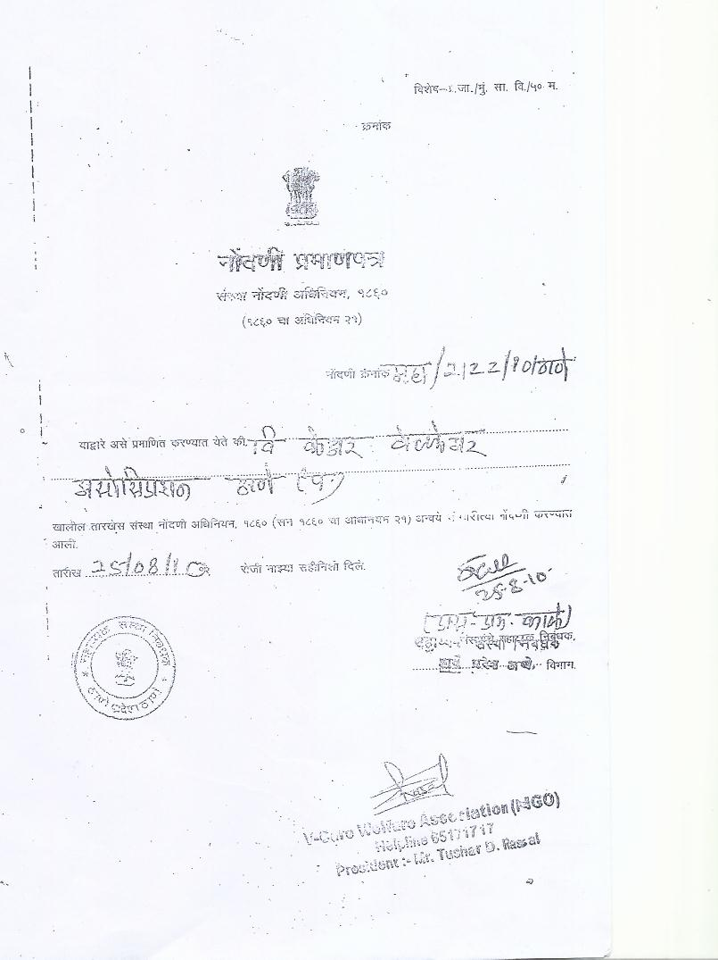
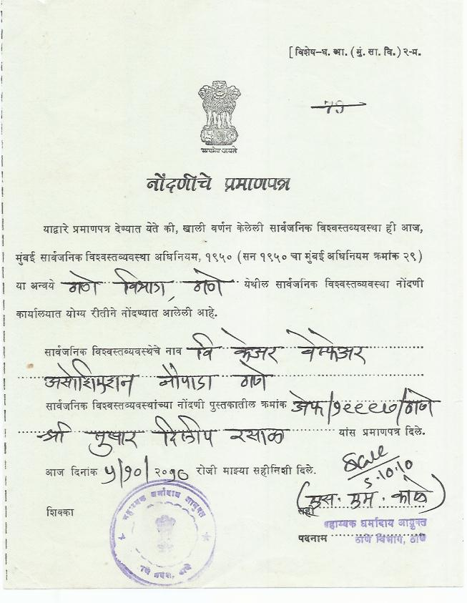
REGISTRATION CERTIFICATE

Slide 3
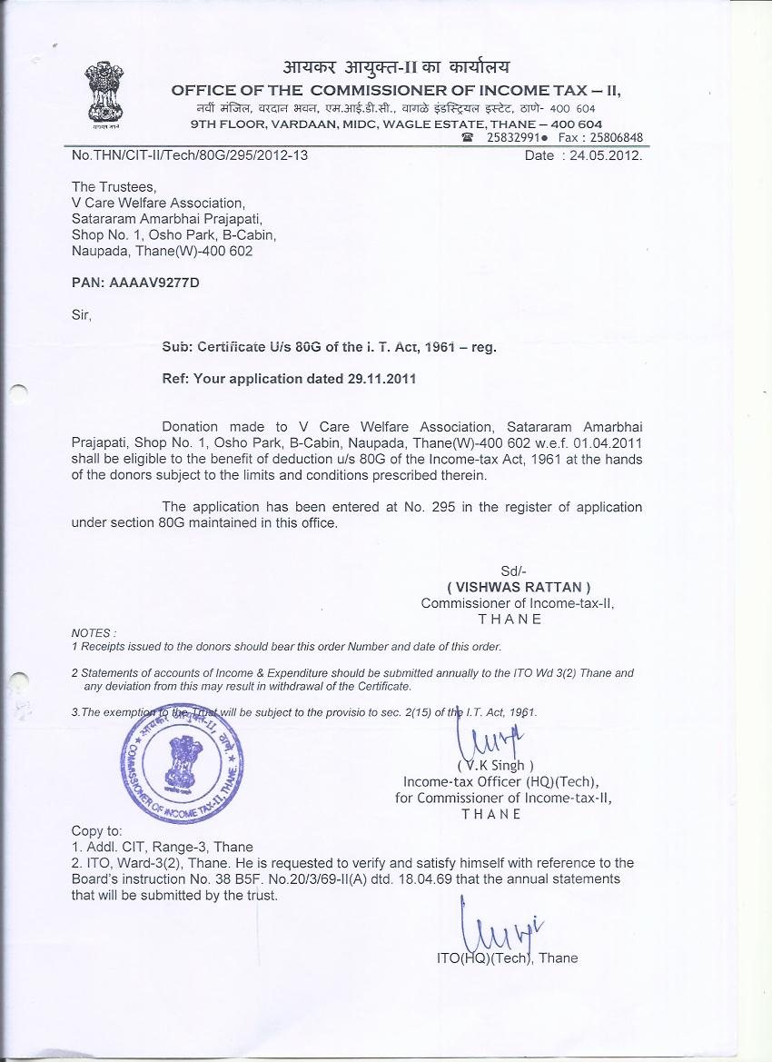
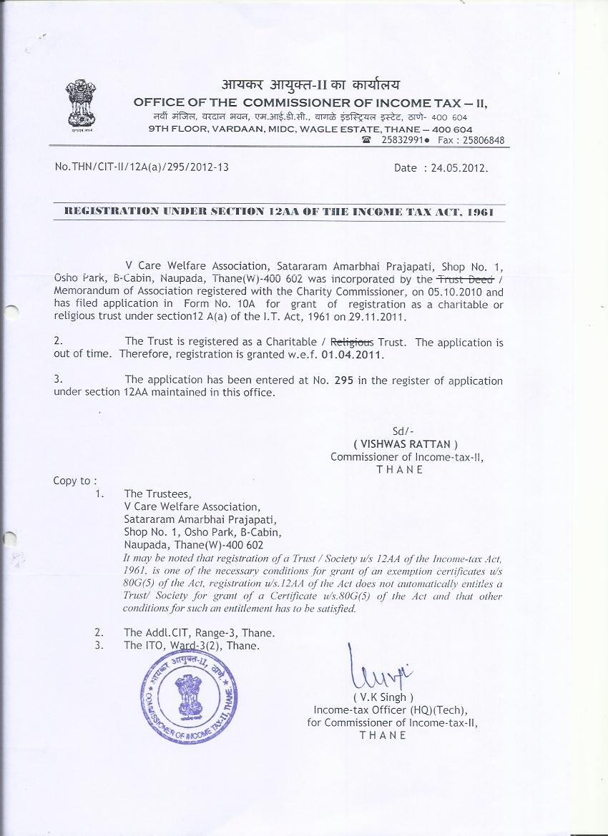
V CARE 80G CERTIFICATE &
12 A CERTIFICATE

Slide 4
V-CARE WELFARE ASSOCATION (N.G.O.) TRUSTEES
Mr. Tushar Dilip Rasal- President
Mr. Nitin Bhoi- Vice President
MR. Pankaj Tawade- Secretary
Mr. Sudarshan Bhoir- Treasurer
Mr. Hemal Boricha
Mr. Jay Dhuri
Mrs. Aarti Rasal
Mr. Mangala karandikar- Chief Advisor
Dr. Jayprakash Ghumatkar- Chief Advisor

Slide 5
V-CARE WELFARE ASSOCATION (N.G.O)
EDUCATION
SPORTS
MEDICAL
DISABLES
POVERTY
ENVIRONMENT

Slide 6
VISION
A strong “giving” culture where Indians donate 2% of their income
every year to give the poor a chance. A happy, healthy and creative
child whose rights are protected and honoured in a society that is built on respect for dignity, justice and equity for all. A vibrant
“philanthropy market place” to ensure that the most efficient and
effective nonprofits get access to the most resources.

Slide 7
MISSION
To enable people to take responsibility for the situation of the
deprived humanbeing and so motivate them to seek resolution
Through individual and collective action thereby enabling children to
realise their full potential for action and change. To enable people’s
Collectives and movements encompassing diverse segment, to pledge
their particular strengths, working in partnership to secure, protect
and honour the rights of India’s children.

Slide 8
OUR BELIFES AND APPROACHES
SACRIFICE :- we believe that every individual must ‘give till it hurts’, demonstrating
the willingness to share one’s fortunes with those less privileged.
DESERVE OUR NEEDS :- we believe that we need to earn our keep, rather than
assume it is as a right. We need to give first and then ask in return.
ADDING VALUE :- we believe that we add value only when we do something that no
one else is currently doing, or when we do it in a better way.
PASSION :- v-care believes that working with a ‘burning desire’ to make a
difference, is the greatest motivator to do something meaningful.
FIRST PRINCIPLES APPROACH :- v-care believes that we must do things because they
make sense to do, and not simply because that is how everyone else does it. Blind faith
is the enemy of all innovation.
FOCUS ON THE POOREST :- all that v-care does is directed towards improving the lives of
our ‘real customer’ – the poorest of the poor.
TRANSPARENCY AND ACCOUNTABILITY :- as ‘trustees’ of tax payer resources, we
believe in being proactively accountable and transparent in that we do and to all our
stakeholders.

Slide 9
PURPOSE
EDUCATION :- we are providing free seminars on sex education, basic computer and IT
education, free beautician courses for women and tutions for those who cant afford heavy
tution fees during academic education process.
POVERTY :- we are trying to change to view of poor people to look after their life and help them
to develop their personal skills in various commercial sector and to get good approurtinity in
job or to run their own small scale business.
ENVIRONMENT :- we are into plantation of various types of trees and preventing them from
Being cutting to maintain ecological balance and increasing global warming.
MEDICAL SECTOR :- we are helping mankind with support if local government authority to run
camps on polio, all kind of vaccionation, total health checkup and blood donation camps.
Beside this we had started charitable hospital at Naupada Thane, Maharashtra to help needy
People.
SPORT :- we want to provide good platform for sports and sport person support sportmen to
achive his/her goal in their sport carrier promoting sport is also our mission.
DISABILITY :- providing help to disables and make them self esteem providing new platform for
disables for their up liftment.

Slide 10
PRIMARY EDUCATION CENTER

Slide 11
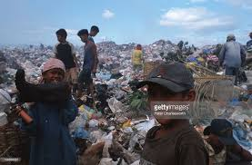
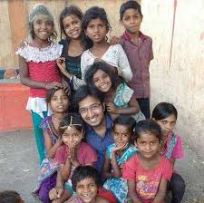
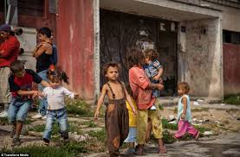
while working in education field we came to know about children of dumping workers who are not taking education due to following reason.
AFFORDABILITY
PARENTS ARE NOT LITRATE
NO TIME FOR CHILDREN

Slide 12
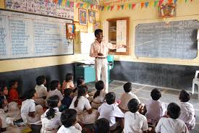
To over come this we had planed to start
Primary education center
near dumping ground.

Slide 13
we appeal you to contribute your valuable contribution in our social cause
CHEQUE SHOULD BE DROWN ON
“V-CARE WELFARE ASSOCIATION”
For NEFT & RTGS
* Account Name:- V-Care Welfare Association (N.G.O).
* Bank Name:- Thane Bharat Sahakari Bank LTD.
* Account No:- 002115000041264.
* Branch:- Main Branch.
*IFSC Code:- TBSB0000002.
* Account Name:- V-Care Welfare Association (N.G.O).
* Bank Name:- State Bank of India
* Account No:- 37621384704.
* Branch:- Naupada Thane.
* IFSC Code:- SBIN0005354

Slide 14
V-CARE WELFARE ASSOCATION (N.G.O.)
REG. OFFICE :- OFFICE O.1, OSHO PARK, SHIVAJI NAGAR, NAUPADA, THANE (W), 400 602.
OFFICE ADDRESS :- OFFICE NO 4,SHREE KRUSHNA APPT, OPP T.B.Z. JWELLERS, NAUPADA ,
SHIVAJI NAGAR, THANE (W), 400602.
HELP LINE NO :- 022-65171717
WEBSITE :- www.vcarengo.org
Email :- info@vcarengo.org

Slide 15
V-CARE WELFARE ASSOCATION (N.G.O.)
THANK YOU
V-CARE
FAMILY

